Slide 1
Goals & Journey Mapping
Week 2 – Lecture and Workshop Slides COMP 3014

Slide 2
Today’s session’s
Review & discuss progress so far
Build a personal persona
Set some high level SMART goals
Start developing your journey map
Notes:
>> Before that

Slide 3

Lock eyes. . .
https://creator.nightcafe.studio/creation/mPl0uQTdTZbRGn6HUNwL
Notes:
Could be your 3013 game
Could be something for a pervious module
Could be your personal brand and portfolio In order to do that. . .

Slide 4
Can you open and log into:
Miro
We’ll need this for the review session and for our journey map.
You’ll use the same board your mind map is on.
Trello
We’ll be using this as we go along.
Teams
Just ‘cause.
Last weeks weekly post thread
This will be helpful for the review

Slide 5
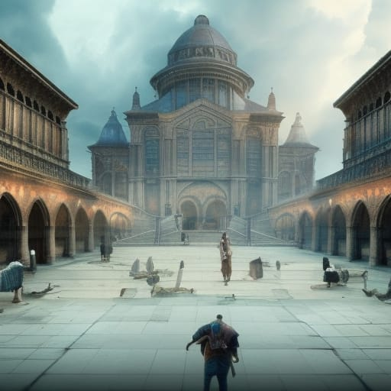
Register
It’s time to register for class.
“Students register their attendance” https://creator.nightcafe.studio/creation/SKkLdAX75aId4Y31P6OK

Slide 6
How have you got on?
1
We started a few things last week. . .

Slide 7


Your Post
Notes:
Was this a smart goal?
Did you know enough to do it?

Slide 8
First week free!
There’s still time to sneak in a post for week 1.
Notes:
Could be your 3013 game
Could be something for a pervious module
Could be your personal brand and portfolio In order to do that. . .

Slide 9
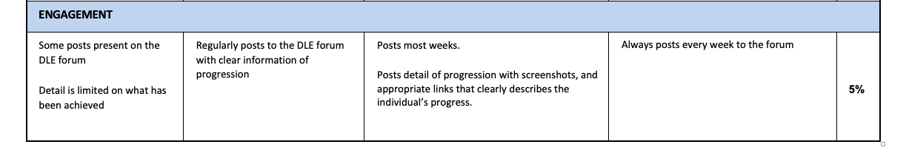
Notes:
Engagement will drive the strategy plan.
There is more value to it than 5%. It’ll improve the 95%

Slide 10
What is a retrospective?
A retrospective is an opportunity to learn and improve. It is time set aside to reflect on past events and behaviours.
The Agile methodology typically suggests asking four questions. . .
Source

Slide 11
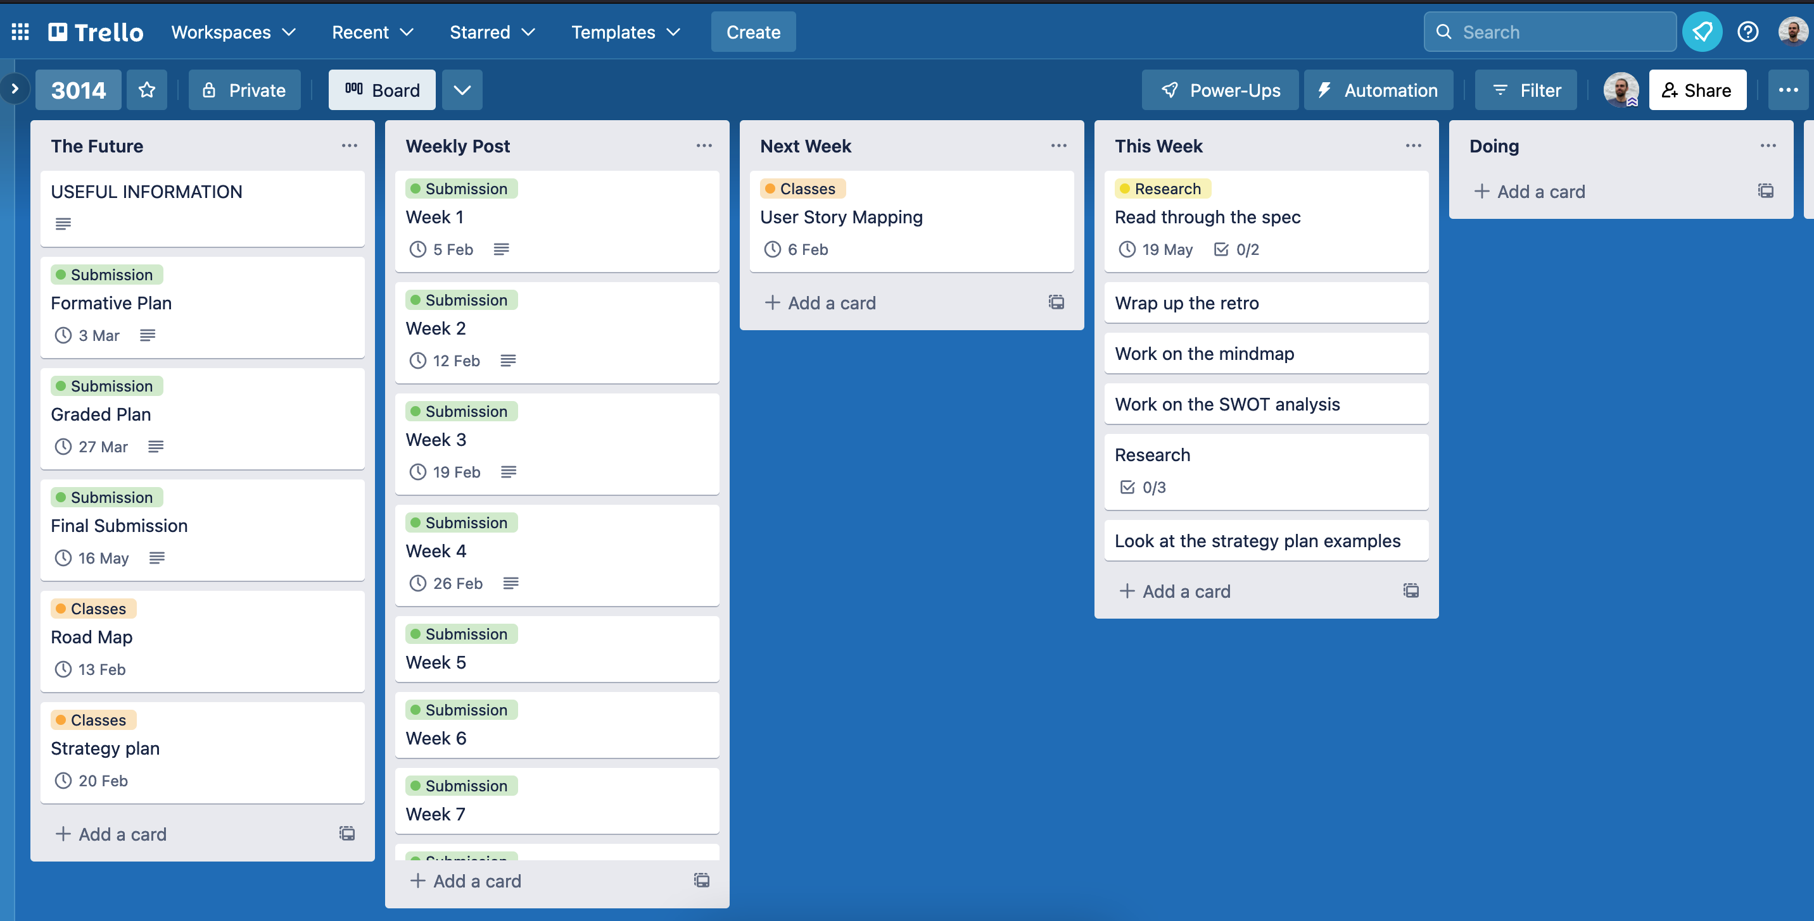
Trello
Manage your module.
Notes:
- Quite prescriptive in the first few weeks
- You might use something different

Slide 12
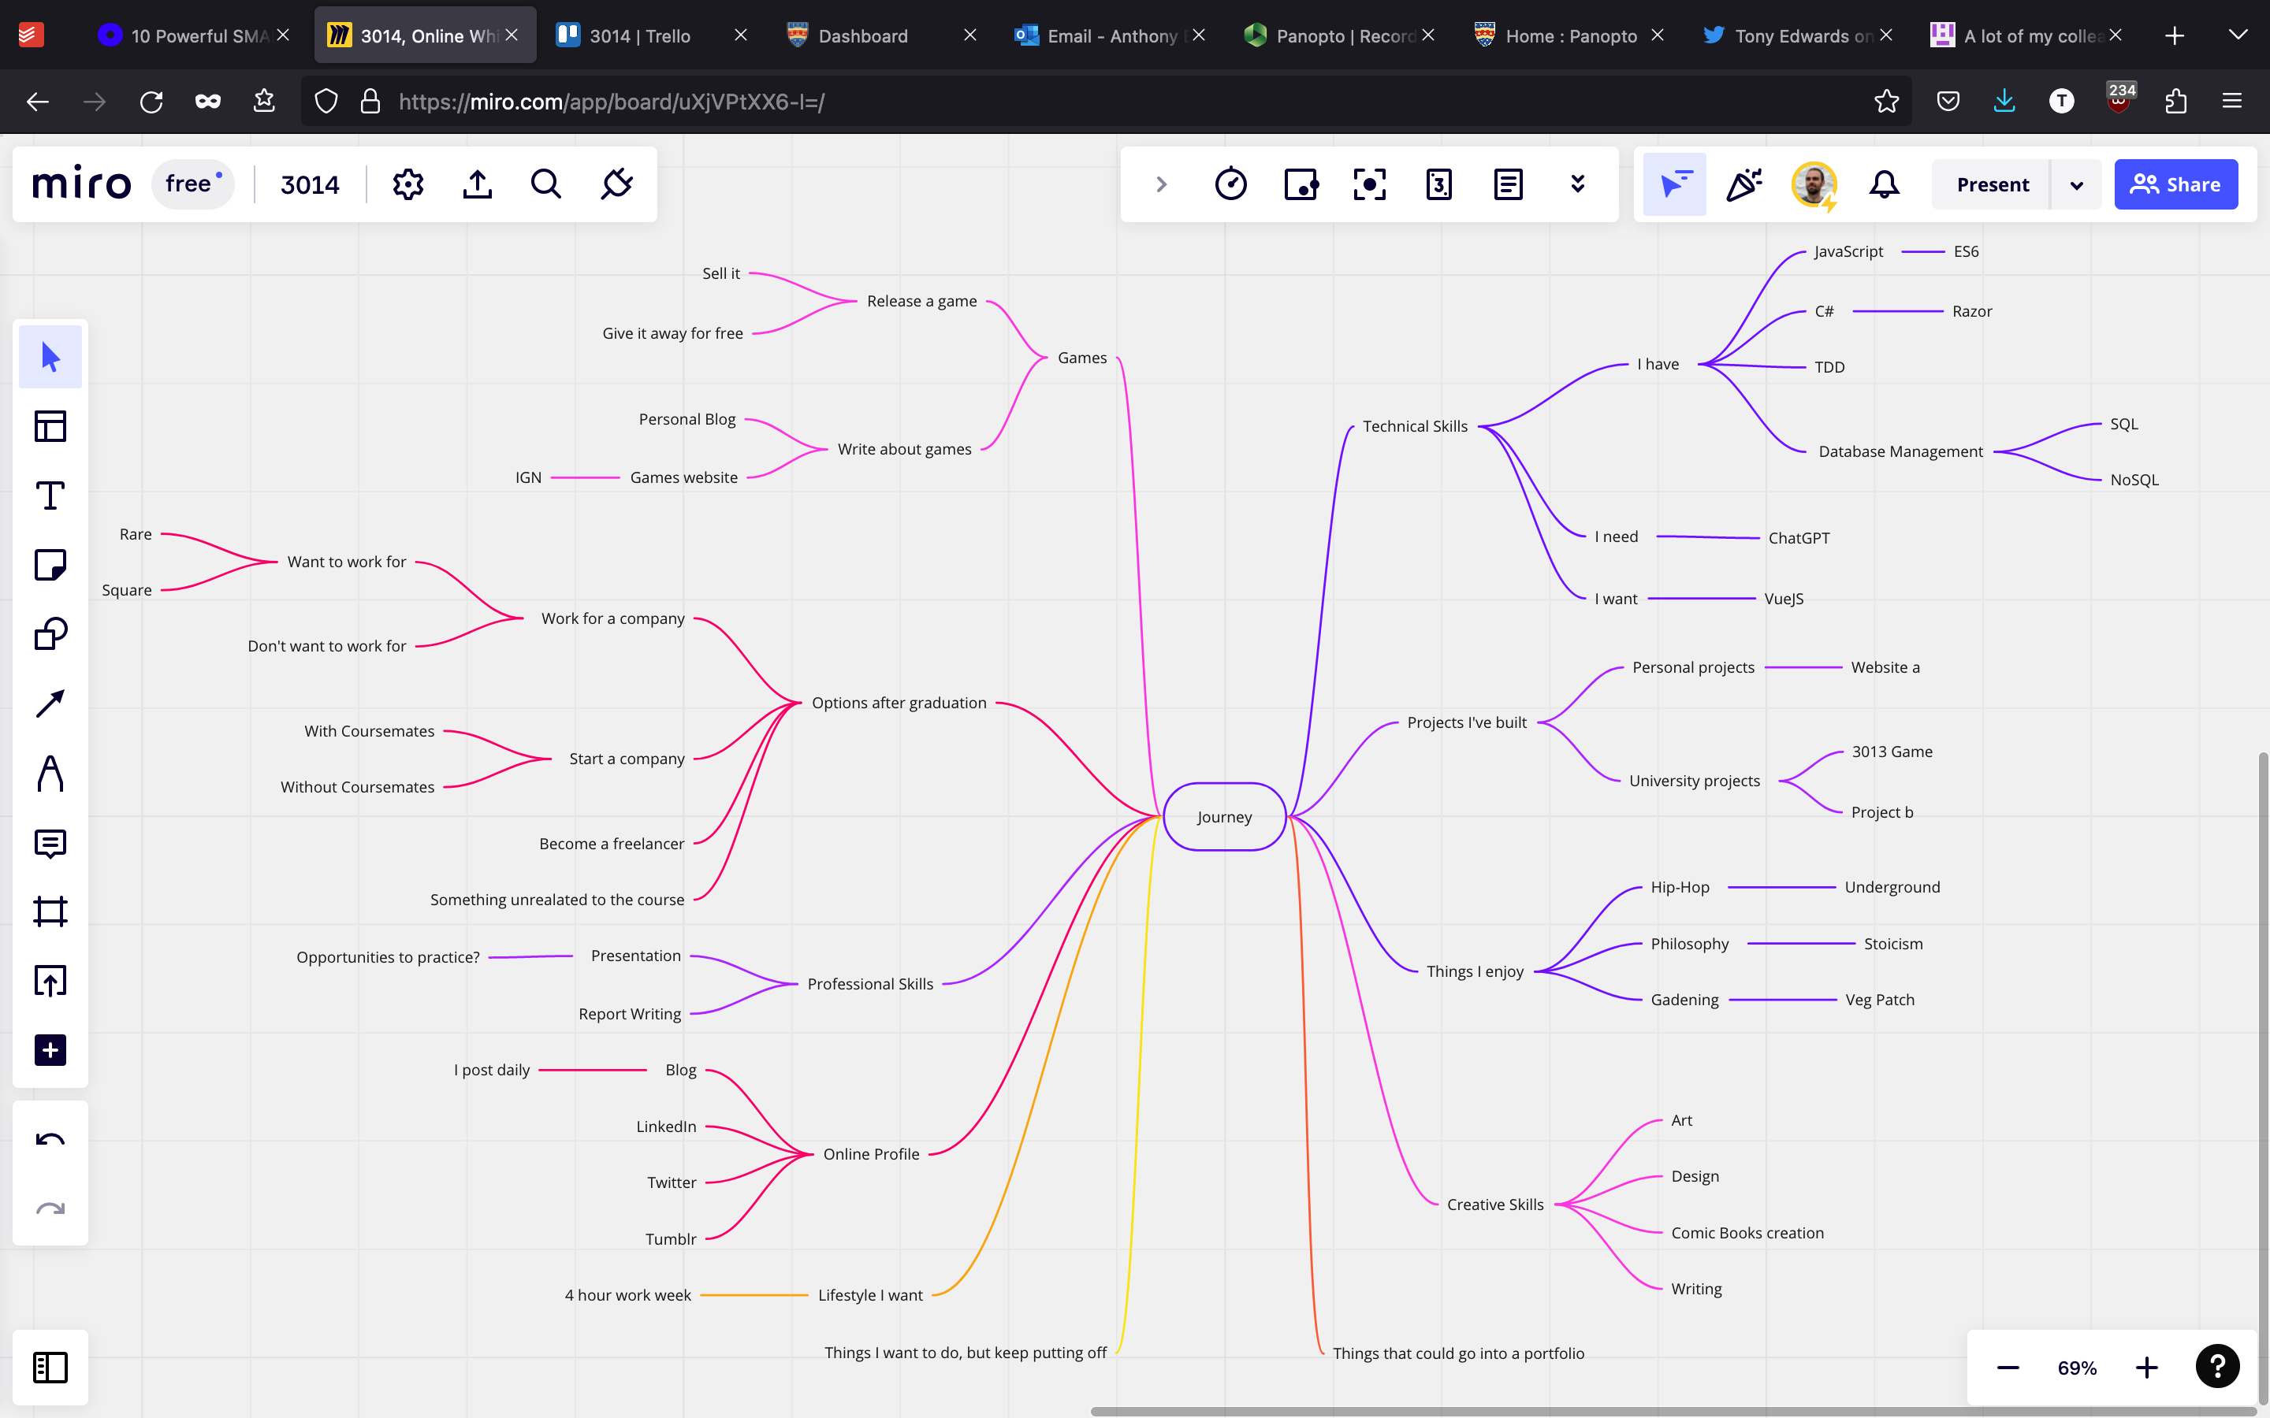
Mind Map
Explore your thoughts
Notes:
- Quite prescriptive in the first few weeks
- You might use something different

Slide 13
SWOT Analysis
STRENGTHS
WEAKNESSES
S
W
OPPORTUNITIES
THREATS
O
T
Notes:
Can be used on any question.
In a game context

Slide 14
Remember that person. . .
https://creator.nightcafe.studio/creation/mPl0uQTdTZbRGn6HUNwL
Notes:
Could be your 3013 game
Could be something for a pervious module
Could be your personal brand and portfolio In order to do that. . .

Slide 15
Your mission is to. . .
Get up
Find each other
And discuss. . .

Slide 16
Mind Map
Did this help you explore your idea?
Take a few minutes discussing each map in turn.
Notes:
- Quite prescriptive in the first few weeks
- You might use something different

Slide 17
Add any new ideas to you Mind Map & SWOT
Notes:
e

Slide 18
Break?

Slide 19
I want you to
Form two lines
The two lines should e facing each other and be equal length
Sort yourselves alphabetically by. . .

Slide 20
First Name

Slide 21
Favourite Game

Slide 22
https://miro.com/app/board/uXjVPtXX6-I=/
Notes:
https://miro.com/app/board/uXjVPtXX6-I=/

Slide 23
User Persona
2

Slide 24


What is a user persona?
Anyone?

Slide 25
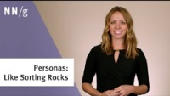

Slide 26
https://miro.com/app/board/uXjVPtXX6-I=/
Notes:
https://miro.com/app/board/uXjVPtXX6-I=/

Slide 27
You might not be able to write the whole thing. . .
But maybe pick out a few epics you know you want to work on after lunch . . .
Notes:
e

Slide 28
https://miro.com/app/board/uXjVPtXX6-I=/
Notes:
https://miro.com/app/board/uXjVPtXX6-I=/

Slide 29
We’re about to watch a video Arrange yourselves accordingly
Notes:
- Add submission dates

Slide 30
https://www.youtube.com/watch?v=R5i8alK5hPo
Notes:
https://www.youtube.com/watch?v=R5i8alK5hPo

Slide 31
Lunch?

Slide 32
Goals & Journey Mapping
Week 2 – Lecture and Workshop Slides COMP 3014

Slide 33
students.sort(fave-game-character)

Slide 34
students.sort(year-first-games-console-released)

Slide 35
SMART Objectives
A form of objec­tive set­ting which allows individuals (and businesses) to cre­ate, track and accom­plish, short-and-long-term goals in a strategic and measurable way.

Slide 36

Which should lead to. . .

Slide 37
SMART Goal Example:
Crap goal: I’m going to write a book
Specific: I’m going to write a 60,000-word sci-fi novel.
Measurable: I will finish writing 60,000 words in 6 months.
Achievable: I will write 2,500 words per week.
Relevant: I’ve always dreamed of becoming a professional writer.
Time-bound: I will start writing tomorrow on January 1st, and finish June 30th.
Which turns into. . .
I’m going to write a 60,000-word novel in 6 months, finishing on June 30th. I will do this by writing 2,500 words per week.
https://www.oberlo.co.uk/blog/smart-goal-examples

Slide 38
You might not be able to write the whole thing. . .
But maybe pick out a few epics you know you want to work on after lunch . . .
Notes:
e

Slide 39
https://miro.com/app/board/uXjVPtXX6-I=/
Notes:
https://miro.com/app/board/uXjVPtXX6-I=/

Slide 40
User Story Map
3
Turn ideas into actions
Notes:
- You’re going to be entering the real world.

Slide 41
User-story mapping is a lean UX-mapping method, that uses sticky notes and sketches to outline the interactions that users to go through to complete their goals (in a digital product). https://www.nngroup.com/articles/user-story-mapping/

Slide 42
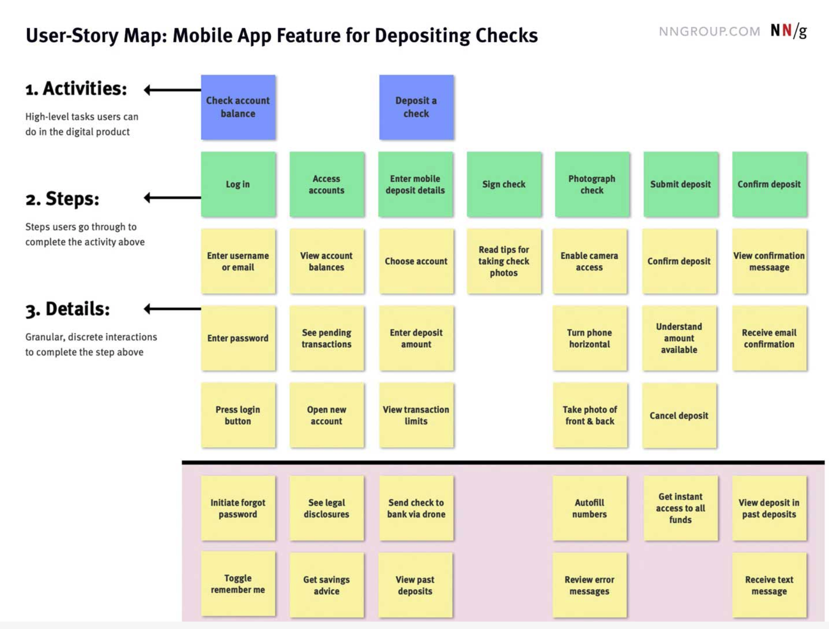
Just a problem solving tool
Notes:
A way to map task to goals

Slide 44
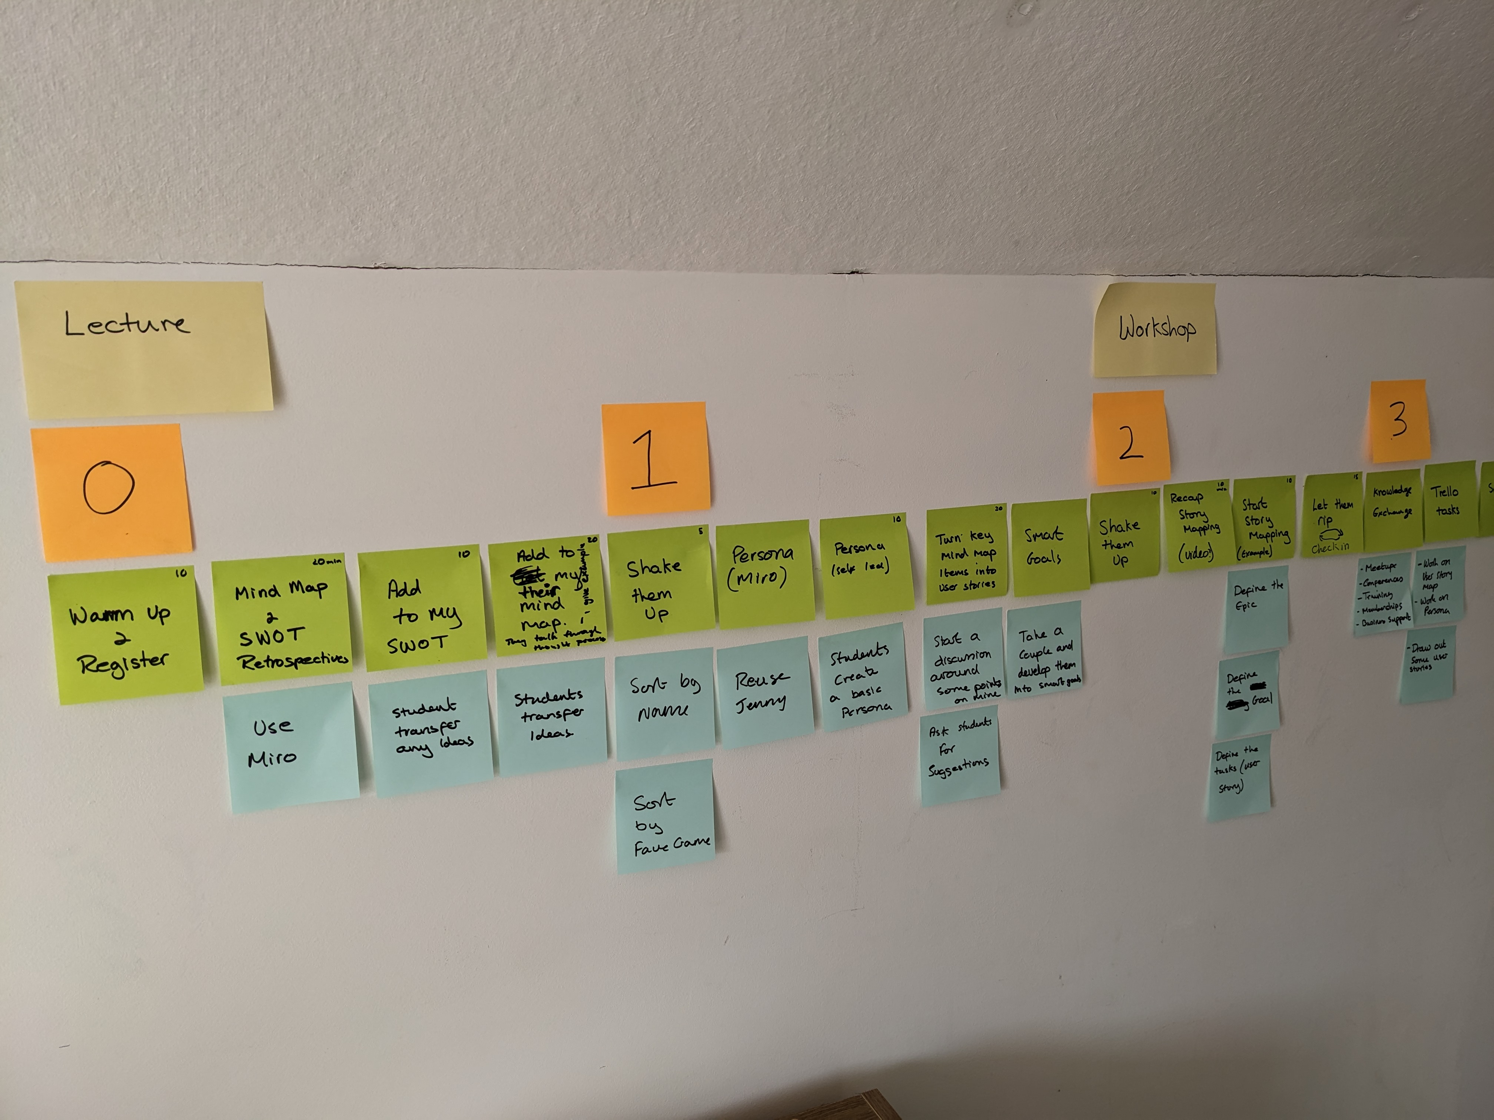

Slide 45


Slide 46
Terminology
EPIC
The highest level activity or goal that needs breaking down.
User Story
The mid level steps you need to take to achieve your goal.
Tasks
The detail of how you’ll incrementally move towards your goal.

Slide 47
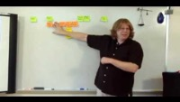

Slide 48
What questions do you have?
?

Slide 49
Follow along. . .
https://miro.com/app/board/uXjVPtXX6-I=/
Notes:
https://miro.com/app/board/uXjVPtXX6-I=/

Slide 50
Ideas Share
Notes:
e

Slide 51
In Teams channel, share:
Any events you’ve found.
Any courses you’re going to look into.
Tools you’ve found useful.
Anything that is going to help on your journey.
Notes:
- Get suggestions from the class

Slide 52
By the next session
At least seven epics on the user story map. The more the merrier.
Complete your persona
Start researching your ideas (and capturing the info)
Mind maps and SWOT where appropriate
Weekly post
Belly laugh. . . . . . plus spend time learning about the concepts we’ve covered. (BEST PRACTICE)

Slide 53
Follow along. . .
https://trello.com/b/hbU9rqx6/3014
Notes:
- Add submission dates

Slide 54

Thanks!
Any questions?
Find me on Teams or via anthony.edwards@plymouth.ac.uk

